Slide 1
Informed Search
https://tutorialforbeginner.com/informed-search-algorithms-in-ai

Slide 2
Problem-solving agents:
Search techniques are universal problem-solving methods in Artificial Intelligence.
These search strategies or algorithms were generally employed by rational agents or problem-solving agents in AI to solve a given problem and provide the best outcome.
Goal-based agents that use atomic representation are problem-solving agents.
We will learn a variety of problem-solving search methods in this area.

Slide 3
Search Algorithm Terminologies:
Search: Searching is a method of solving a search problem in a given search space by following a set of steps. There are three basic variables that can contribute to a search problem:
Search Space: A search space is a collection of probable solutions that a system could have.
Search State: It's the starting point for the agent's quest.
Goal test: This is a function that looks at the current state and returns whether or not the goal state has been achieved.
Search tree: The term "search tree" refers to a tree representation of a search problem. The root node, which corresponds to the initial state, is at the top of the search tree.
Actions: It gives the agent a description of all the actions that are available to him.
Transition model: A transition model can be used to represent a description of what each action does.
Path Cost: It is a function that gives each path a numeric cost.
Goal Node: It is an action sequence that connects the start node and the goal node.
Optimal Solution: If a solution has the lowest cost of all the solutions, it is said to be the optimal solution.

Slide 4
Properties of Search Algorithms:
The four most important properties of search algorithms to compare their efficiency are as follows:
Completeness: If a search method guarantees to return a solution if at least one solution exists for any random input, it is said to be complete.
Optimality: A solution obtained for an algorithm is considered to be optimal if it is guaranteed to be the best solution (lowest route cost) among all other solutions.
Time Complexity: It is a measurement of how long it takes an algorithm to finish a task.
Space Complexity: The maximum storage capacity required at any time during the search, as measured by the problem's complexity.

Slide 5
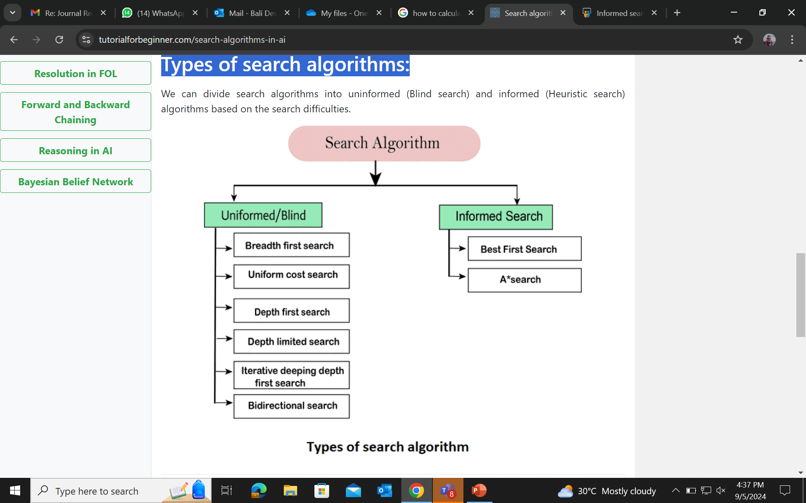
Types of search algorithms:

Slide 6
What is Uninformed Search Algorithms?
Uninformed search is a class of general-purpose search algorithms which operates in brute force-way. Uninformed search algorithms do not have additional information about state or search space other than how to traverse the tree, so it is also called blind search.
The various types of uninformed search algorithms are as follows:
Breadth-first Search
Depth-first Search
Depth-limited Search
Iterative deepening depth-first search
Uniform cost search
Bidirectional Search

Slide 7
1. Breadth-first Search:
The most frequent search approach for traversing a tree or graph is breadth-first search. Breadth-first search is the name given to an algorithm that searches a tree or graph in a breadth-first manner.
A FIFO queue data structure was used to implement a breadth-first search.
Advantages:
If a solution is available, BFS will provide it.
If there are multiple answers to a problem, BFS will present the simplest solution with the fewest steps.
Disadvantages:
It necessitates a large amount of memory since each level of the tree must be saved into memory before moving on to the next.
If the solution is located far from the root node, BFS will take a long time.

Slide 8
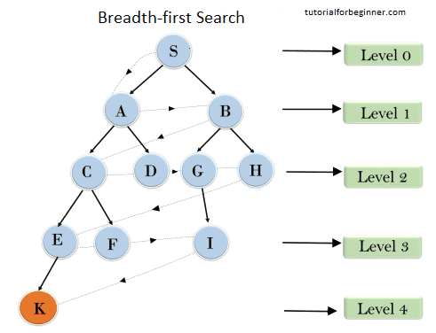

Slide 9
Time Complexity: The number of nodes traversed in BFS till the shallowest Node can be used to determine the algorithm's time complexity. Where d represents the depth of the shallowest solution and b represents a node at each state.
Space Complexity: Space complexity of BFS algorithm is given by the Memory size of frontier which is O(b^{d}).
Completeness: BFS is complete, which means it will discover a solution if the shallowest target node is at a finite depth.
Optimality: BFS is optimal if the path cost is a non-decreasing function of the node's depth.

Slide 10
Depth-first Search
A recursive approach for traversing a tree or graph data structure is depth-first search.
The depth-first search is named after the fact that it begins at the root node and follows each path to its greatest depth node before going on to the next path.
DFS is implemented using a stack data structure.
The DFS algorithm works in a similar way as the BFS method.
Note: Backtracking is a recursive algorithm strategy for identifying all possible answers.
Advantage:
Because DFS only needs to store a stack of nodes on the path from the root node to the current node, it uses extremely little memory.
It takes less time to reach the goal node than the BFS method (if it traverses in the correct order).
Disadvantage:
There's a chance that many states will recur, and there's no certainty that a solution will be found.
The DFS algorithm performs deep searching and may occasionally enter an infinite cycle.

Slide 11
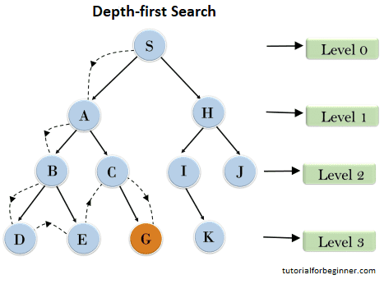
Right node ----> root node ----> left node

Slide 12
Completeness: Within a finite state space, the DFS search algorithm is complete since it expands every node within a constrained search tree.
Time Complexity: DFS's time complexity will be equal to the number of nodes traversed by the algorithm. It is provided by:
T(n)= 1+ n²+ n³ +.........+ n^{m} = O(n^{m})
Where m is the greatest depth of any node, which can be significantly greater than d. (Shallowest solution depth)
Space Complexity: Because the DFS algorithm only has to record one path from the root node, its space complexity is equal to the size of the fringe set, which is O. (bm).
Optimal: DFS search algorithm is not optimum since it may result in a huge number of steps or a high cost to reach the goal node.

